Slide 1




Week-9 (Discussion)
23rd September, 2024
Introduction to Machine Learning
Prof. Balaraman Ravindran
Professor and Head of the Department
Department of Data Science and Artificial Intelligence
IIT Madras
Ayan Paul
PMRF Research Scholar
IIT Kharagpur

Slide 2
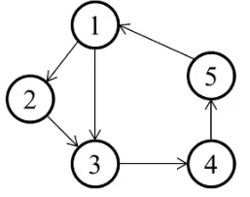
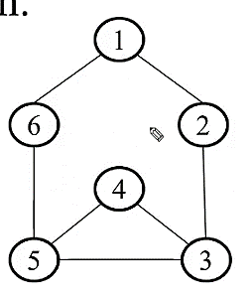
Graph Theory
A branch of mathematics that deals with the study of graphs and it consists of a set of vertices(nodes) connected by edges.
Directed Graph
Undirected Graph
A directed graph is a graph that is unidirectional in this the edges have a specific direction and the edges have directions specified with them.
Ordered Pair of Vertices
Notation: The edge from A to B is denoted as (A→B) or A → B.
An undirected graph is a graph where the edges do not have a specific direction and it is bidirectional in nature it does not have a parent-child relation concept as there is no particular direction.
Unordered Pair of Vertices
Notation: An edge between A and B is denoted as (A↔B) or simply A−B
G(V,E) = {(1,2), (2,3), (3,4), (4,5), (5,1), (1,3)}
Such that (1,2) ≠ (2,1) [Asymmetry]
G(V,E) = [{1,6}, {6,5}, {5,4}, {4,3}, {5,3}, {3,2},{2,1}]
Such that {1,6} = {6,1} [Symmetry]
Applications: Bayesian Networks, Transportation Networks etc.
Applications: Social Networks, Communication Networks etc.

Slide 3
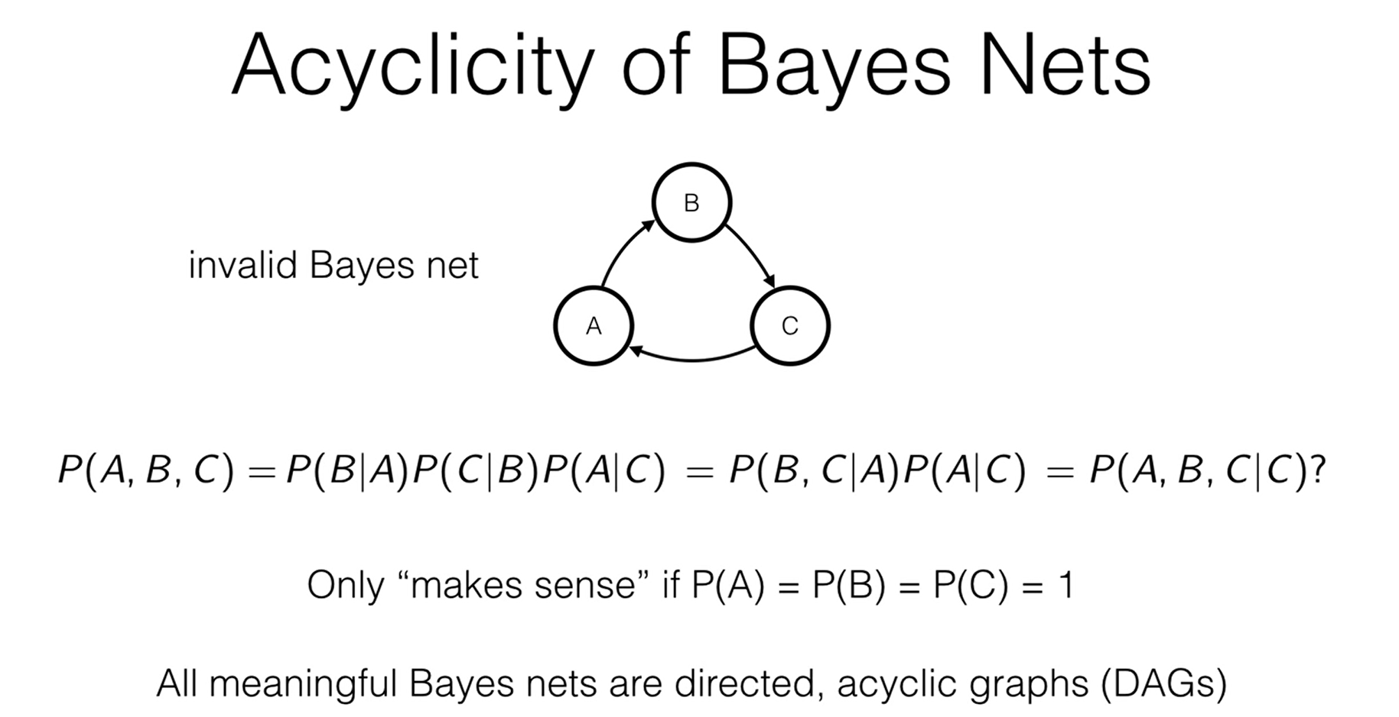

Acyclicity of Bayes Networks
Markov Random Field
A Markov network or MRF is similar to a Bayesian network in its representation of dependencies; the differences being that Bayesian networks are directed and acyclic, whereas Markov networks are undirected and may be cyclic.
Thus, a Markov network can represent certain dependencies that a Bayesian network cannot (such as cyclic dependencies)
Markov Property (Markov Blanket): A random variable in an MRF is conditionally independent of all other variables given its neighbors (the variables directly connected to it).

Slide 4
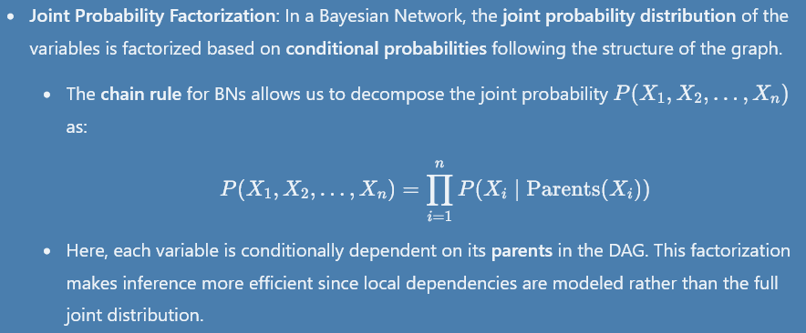
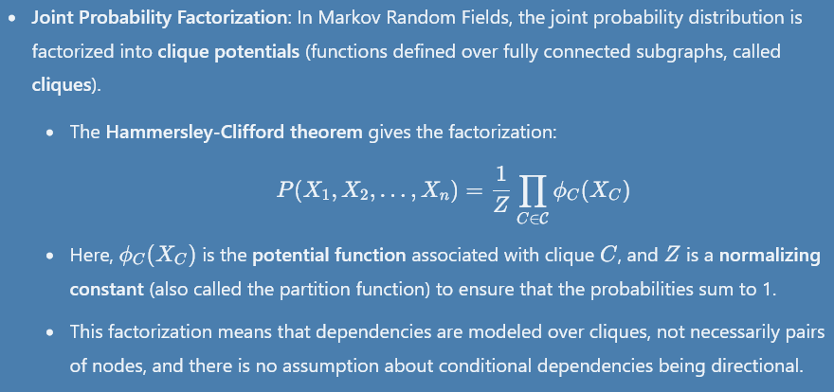
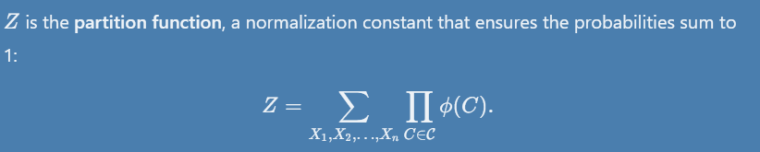
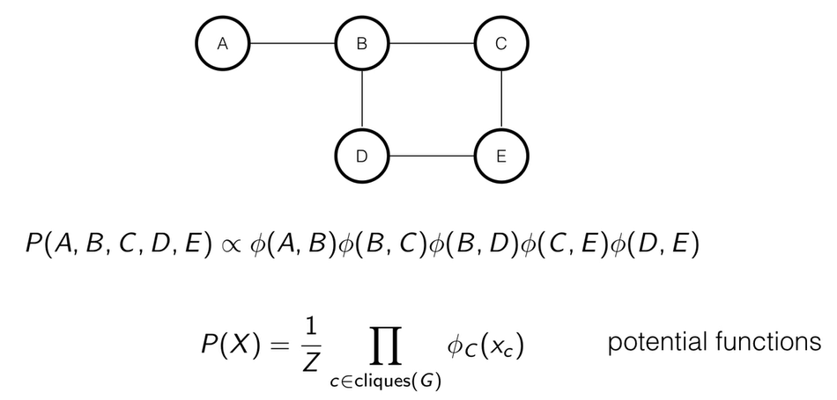
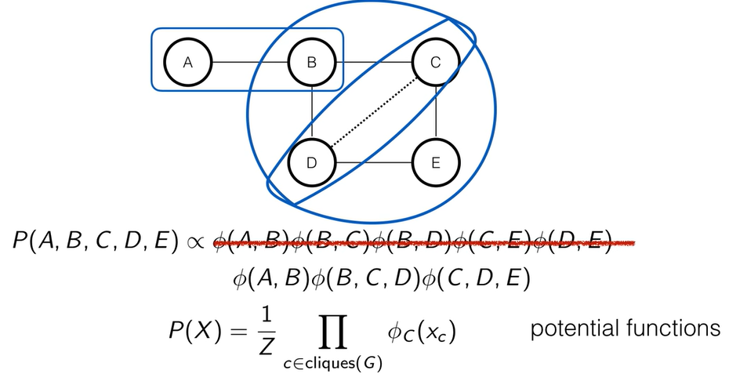
Factorization comparison in Bayesian and Undirected Graph
Bayesian Network
Markov Random Field
Examples of Factorization in Markov Random Fields

Slide 5
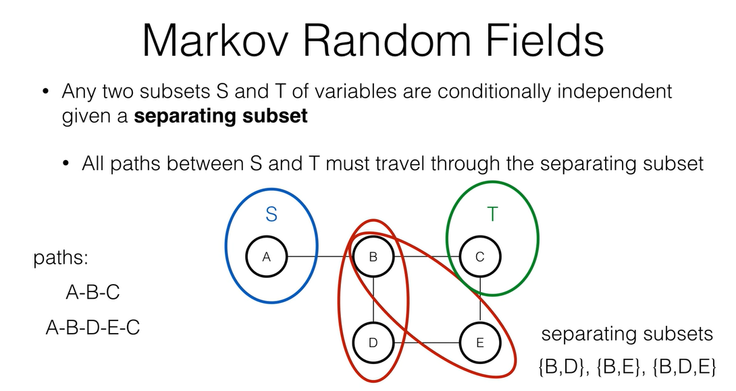
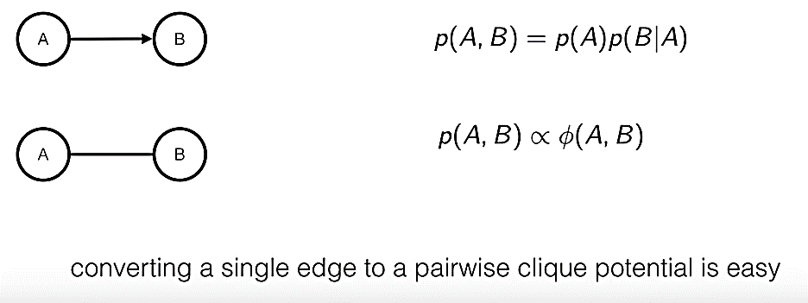
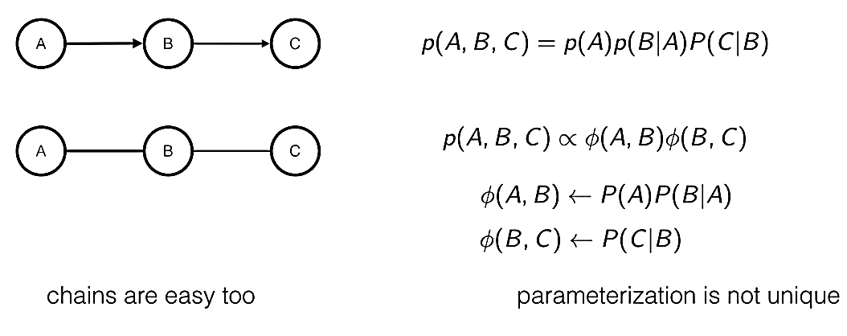
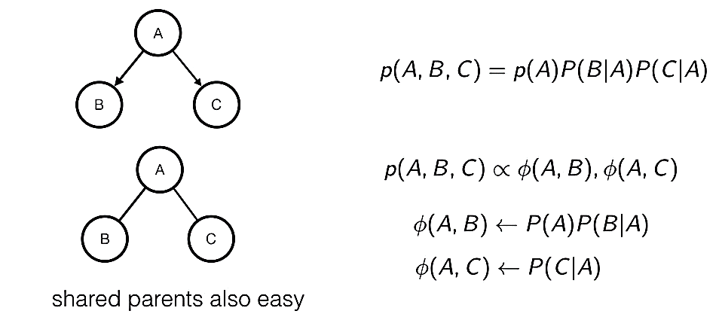
Connectivity in MRF
Bayesian Network as MRF

Slide 6
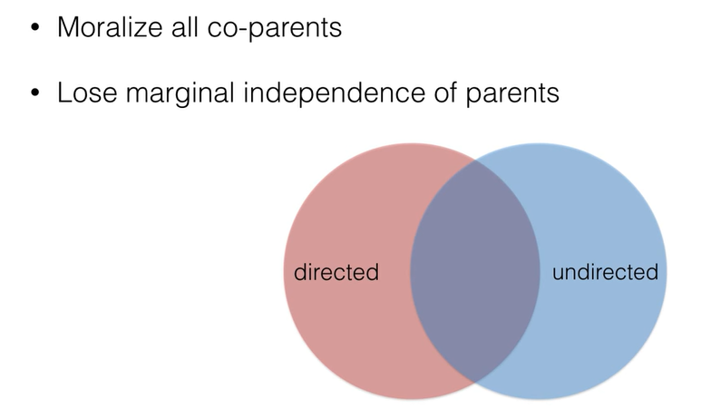
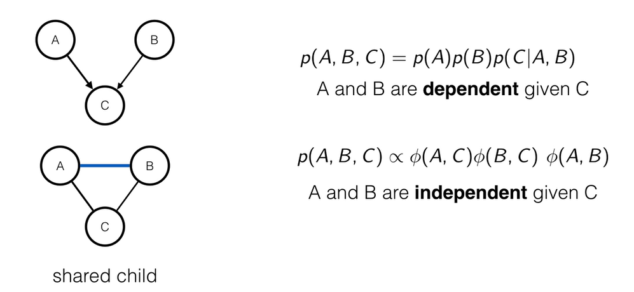
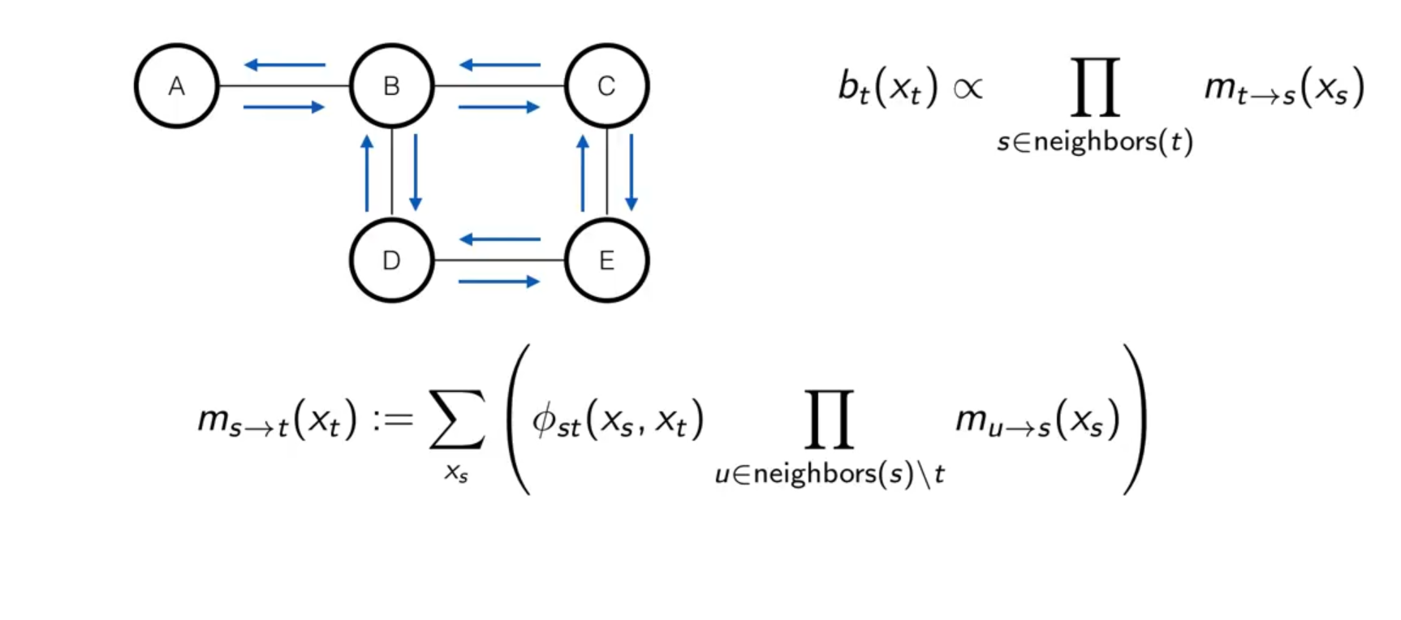
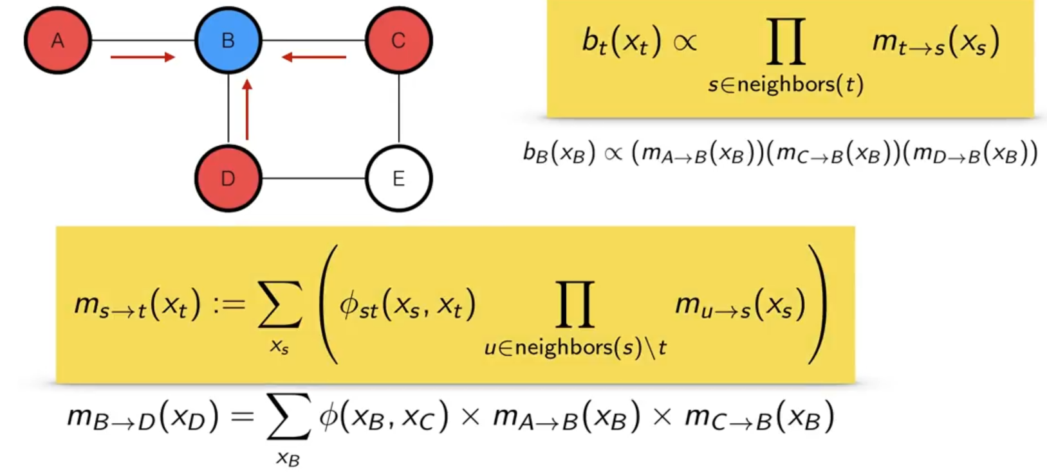
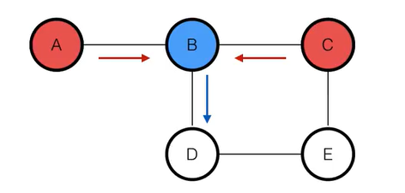
Moralizing Parents
Belief Propagation
Belief propagation, also known as sum–product message passing, is a message-passing algorithm for performing inference on graphical models, such as Bayesian networks and Markov random fields.
It calculates the marginal distribution for each unobserved node (or variable), conditional on any observed nodes (or variables)
D

Slide 7
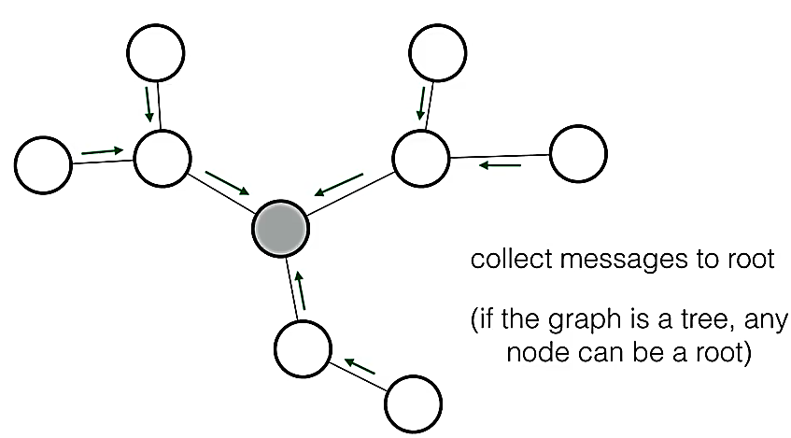
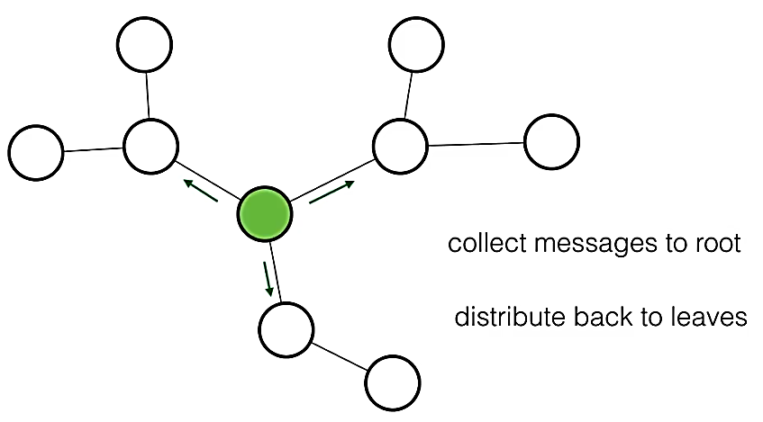
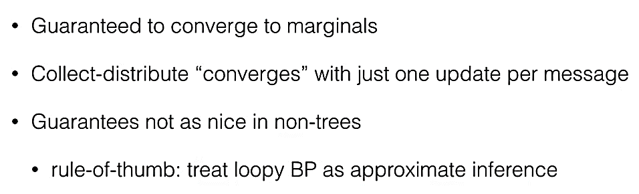
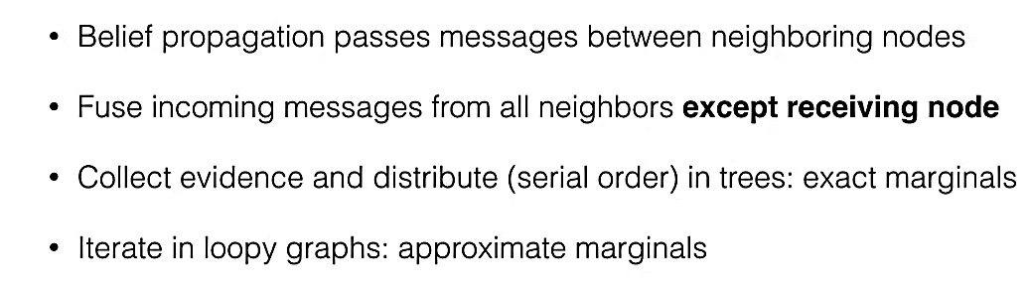
BP in Trees
Summary for BP

Slide 8
Topics on which Week 9 Assignment Questions are based
Undirected Graphical Models
Markov Model
Belief Propagation

Slide 9
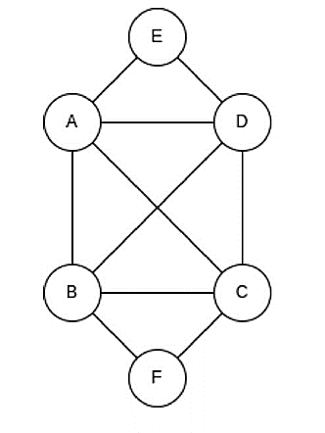
QUESTION 1
In the undirected graph given below, how many terms will be there in its potential function factorization?
7
3
5
9
SOLUTION 1
It will be same as maximum number of cliques in the graph: (A, B, C, D), (A, E, D), (B, C, F)
So, Maximum number of cliques are 3
CORRECT ANSWER 1
b)

Slide 10
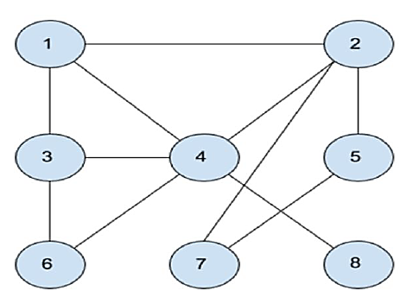
QUESTION 2
Consider the Markov network shown in the figure. Which one of the following is not in Markov blanket of variable “4”?
1
8
2
5
6
4
7
SOLUTION 2
The neighbors of “4” are 1, 3, 6, 8 and 2. so they are in the Markov blanket of variable “4”.
CORRECT ANSWER 2
d), g)

Slide 11
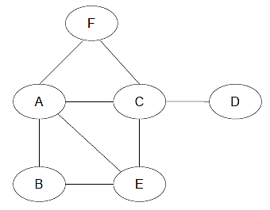
QUESTION 3
Consider the Markov Random Field. Which of the nodes has / have the largest Markov blanket (i.e. the Markov blanket with the most number of nodes)? (One or more correct options)
(a) A
(b) B
(c) C
(d) D
(e) E
(f) F
SOLUTION 3
In an MRF, the Markov blanket of a node comprises of its immediate neighbours. Nodes A and C have four neighbours each while the other nodes have fewer than four neighbours. Hence, A and C have the largest Markov blankets.
CORRECT ANSWER 3
a), c)

Slide 12
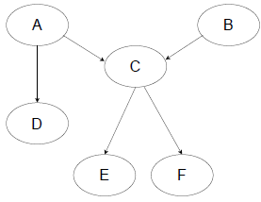
QUESTION 4
Consider the Bayesian Network given below. Which of the following independence relations hold? (One or more correct options)
(a) A and B are independent if C is given
(b) A and B are independent if no other variables are given
(c) C and D are not independent if A is given
(d) A and F are independent if C is given
SOLUTION 4
C is a common descendant of A and B. So, A and B are not independent if C is given.
P(A,B,C,D,E, F) = P(A)P(B)P(D|A)P(C|A,B)P(E|C)P(F|C). Marginalizing over C, D, E, F, we get P(A,B) = P(A)P(B). Thus, A and B are marginally independent.
A is a parent of both C and D. So. C and D are independent if A is given.
We have a directed path A → C → F. So, A and F are independent if C is given.
CORRECT ANSWER 4
b), d)

Slide 13

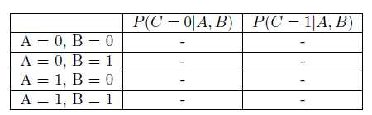

QUESTION 5
In the Bayesian Network from question 4, assume that every variable is binary. What is the number of independent parameters required to represent all the probability tables for the distribution?
(a) 8 (b) 12 (c) 16 (d) 24 (e) 36
SOLUTION 5
To fully specify the distribution, we would need tables corresponding to P(A), P(B), P(C|A,B), P(D|A), P(E|C), P(F|C).The table for P(A) would appear as follows. It has 1 independent parameter since P(A = 1) can be determined given P(A = 0). The table structure is similar for P(B), which also has 1 parameter.
The table for P(C|A,B) would appear as follows. It has 4 independent parameters, where each parameter corresponds to a row. Given one of the entries in a row, we can determine the other one.
The table for P(D|A) would appear as follows. It has 2 independent parameters, where each parameter corresponds to a row. Given one of the entries in a row, we can determine the other one. Since P(E|C) and P(F|C) have a similar structure, they also have 2 independent parameters each.
Hence, the total number of independent parameters is 1 + 1 + 4 + 2 + 2 + 2 = 12
CORRECT ANSWER 5
b)

Slide 14
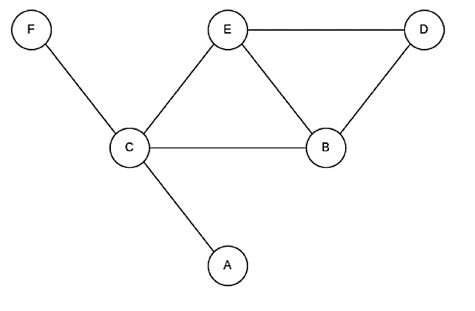
QUESTION 6
In the undirected graph given below, which nodes are conditionally independent of each other given B?
A, D
D, E
C, D
A, F
None of the above
SOLUTION 6
All pairs have an alternate route to each other that does not pass through B
CORRECT ANSWER 6
e)

Slide 15
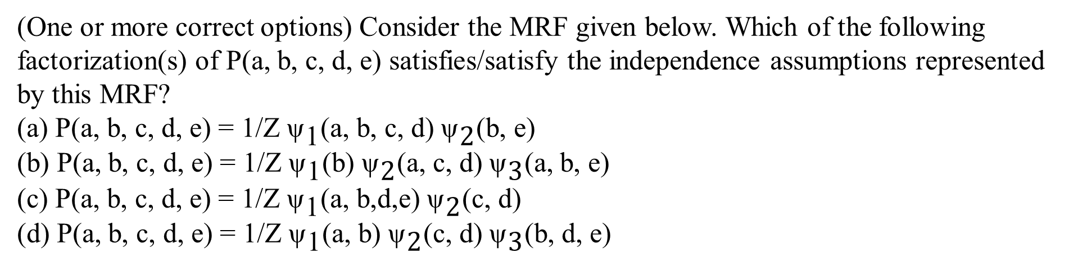
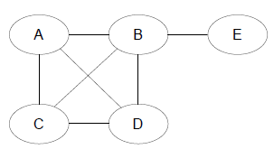
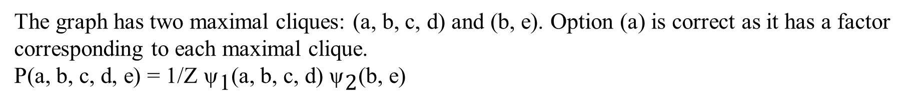
QUESTION 7
SOLUTION 7
CORRECT ANSWER 7
a)

Slide 16
QUESTION 8
Which of the following best describes the Markov property in a Hidden Markov Model (HMM)?
The future state depends on the current state and the entire past sequence of states.
The future state depends only on the current state and is independent of the past states, given the current state.
The future state depends on the past states and the future states, given the current state.
The future state depends only on the past states and is independent of the current state.
SOLUTION 8
The future state depends only on the current state and is independent of the past states, given the current state.
CORRECT ANSWER 8
b)

Slide 17
QUESTION 9
What is the main objective of Belief Propagation in a graphical model?
To compute the shortest path between two nodes.
To calculate the marginal probabilities for each node.
To find the maximum likelihood path in a graph.
To determine the posterior distribution of hidden variables.
SOLUTION 9
The main objective of Belief Propagation (BP) is to compute the marginal probabilities of each node in a graphical model, specifically in probabilistic graphical models such as Bayesian Networks or Markov Random Fields (MRFs).
CORRECT ANSWER 9
b)

Slide 18
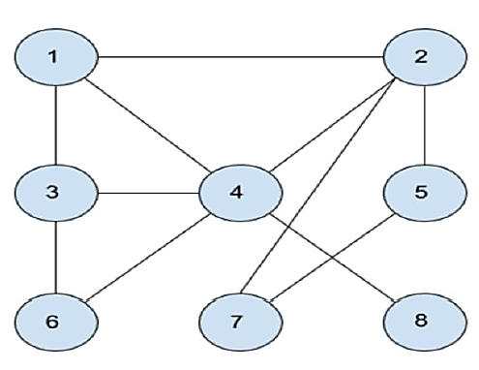
QUESTION 10
In the Markov network given in the figure, two students make
the following claims
• Manish claims variable “1” is dependent on variable “7” given
variable “2”.
• Trina claims variable “2” is independent of variable “6” given
variable “3”.
Which of the following is true?
(a) Both the students are correct.
(b) Trina is incorrect and Manish is correct.
(c) Trina is correct and Manish is incorrect.
(d) Both the students are incorrect.
(e) Insufficient information to make any conclusion.
SOLUTION 10
Statement 1: If we block 2 then there’s no path between 1 and 7. Therefore 1 and 7 is independent given 2. ⇒ Manish is incorrect
Statement 2: If we block 3 then also there is a path to reach from 2 to 6 via 4. Therefore 2 is dependent on 6 given 3. ⇒ Trina is incorrect
CORRECT ANSWER 10
d)

